Slide 1
Transmission Impairment and Network Performance

Slide 2
Topics of Discussion
Transmission Impairment
- Attenuation
- Distortion
- Noise
Data Rate Limits
- Nyquist rate
- Shannon capacity
Network Performance
- Bandwidth
- Throughput
- Latency
- Jitter

Slide 3
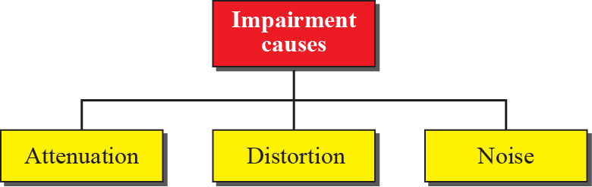
Impairment
Signals travel through transmission media, which are not perfect. The imperfection causes signal impairment. This means that the signal at the beginning of the medium is not the same as the signal at the end of the medium. What is sent is not what is received. Three causes of impairment are attenuation, distortion, and noise.

Slide 4
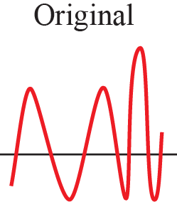
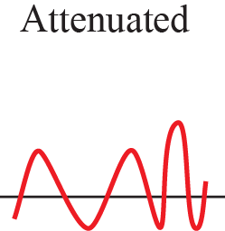
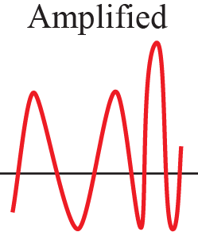
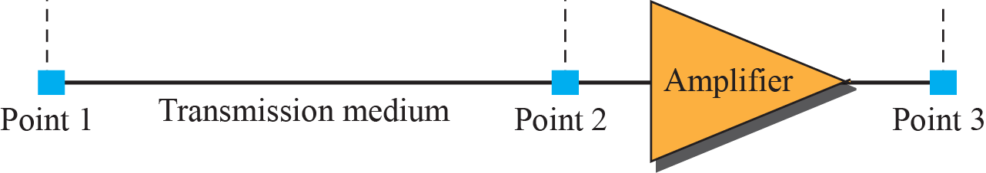
Attenuation
. Attenuation means a loss of energy. When a signal, simple or composite, travels through a medium, it loses some of its energy in overcoming the resistance of the medium. To compensate for this loss, amplifiers are used to amplify the signal.
Figure 1 : Attenuation and amplification

Slide 5
Example 1: A signal travels through a transmission medium and its power is reduced to one half. What will be the attenuation (loss of power).
Solution: Here, P2 = 0.5 P1. So, the attenuation (loss of power) can be calculated as

Slide 6

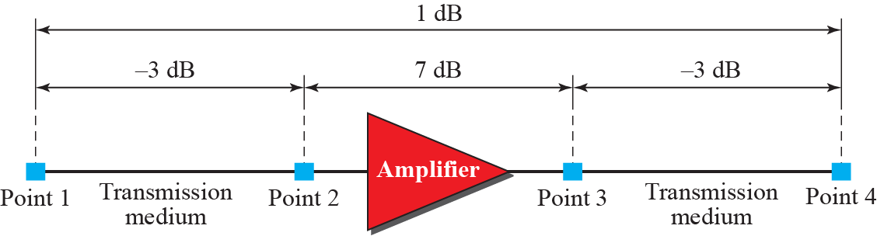
Example 2
One reason that engineers use the decibel to measure the changes in the strength of a signal is that decibel numbers can be added (or subtracted) when we are measuring several points (cascading) instead of just two. In Fig. 2, we can find the resultant decibel value for the signal just by adding the decibel measurements between each set of points. In this case, the decibel value can be calculated as
Figure 2: Example for Decibels

Slide 7
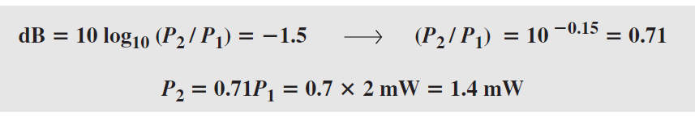
Example 3
Sometimes the decibel is used to measure signal power in milliwatts. In this case, it is referred to as dB_{m} and is calculated as dB_{m} = 10 log10 P_{m}, where Pm is the power in milliwatts. What will be the power of a signal if its dB_{m} = −30?
Example 4
The loss in a cable is usually defined in decibels per kilometer (dB/km). If the signal at the beginning of a cable with −0.3 dB/km has a power of 2 mW, what is the power of the signal at 5 km?
Solution: The loss in the cable in decibels is 5 × (−0.3) = −1.5 dB. We can calculate the power as

Slide 8
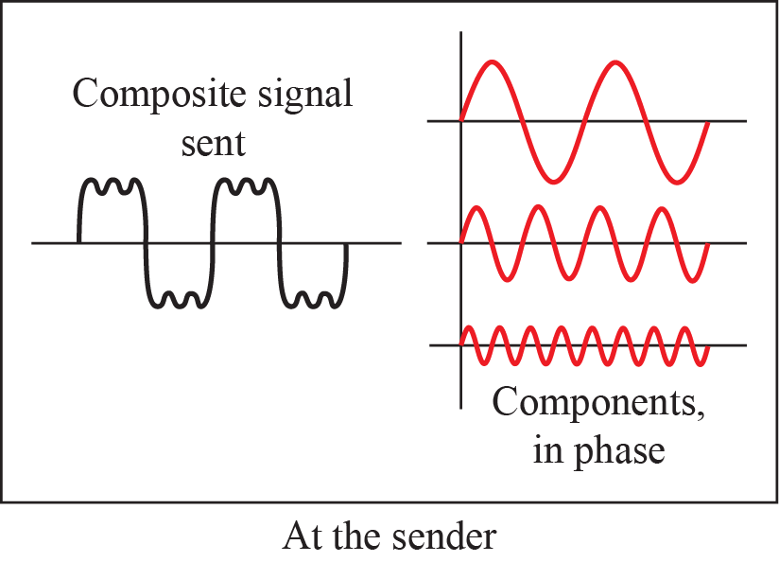
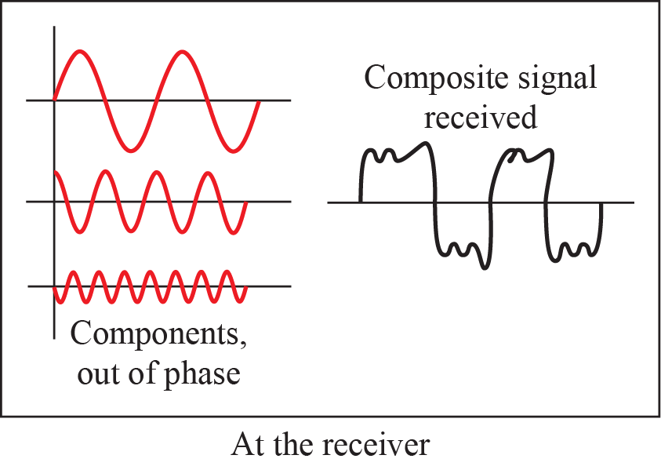
Distortion
Distortion means that the signal changes its form or shape. Distortion can occur in a composite signal made of different frequencies. Each signal component has its own propagation speed through a medium and, therefore, its own delay in arriving at the final destination. Differences in delay may create a difference in phase if the delay is not exactly the same as the period duration.

Slide 9
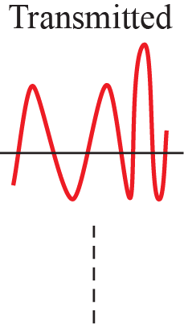
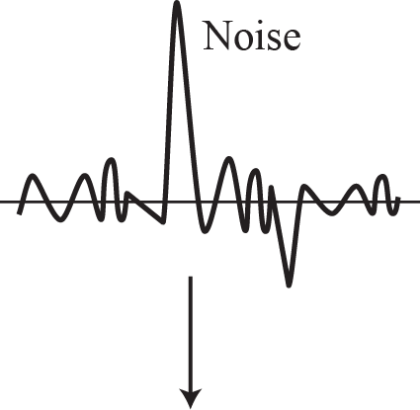
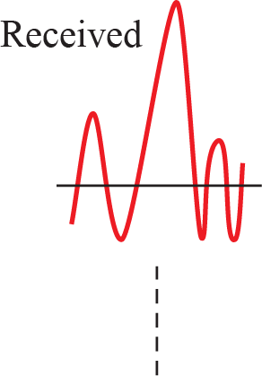
Noise
Noise is another cause of impairment.
  Thermal - random noise of electrons in the wire creates an extra signal
  Induced - from motors and appliances, devices act are transmitter antenna and medium as receiving antenna.
  Crosstalk - same as above but between two wires.
  Impulse - Spikes that result from power lines, lightening, etc.

Slide 10
Signal to Noise Ratio (SNR)
To measure the quality of a system the SNR is often used. It indicates the strength of the signal w.r.t. the noise power in the system.
It is the ratio between two powers.
It is usually given in dB and referred to as SNR_{dB.}
Example 5
The power of a signal is 10 mW and the power of the noise is 1 μW; what are the values of SNR and SNR_{dB}?
Solution : The values of SNR and SNR_{dB} can be calculated as follows:

Slide 11

Figure 3: Two cases of SNR: a high SNR and a low SNR

Slide 12


Data rate Limits
A very important consideration in data communications is how fast we can send data, in bits per second, over a channel. Two theoretical formulas were developed to calculate the data rate: one by Nyquist for a noiseless channel, another by Shannon for a noisy channel.
Noiseless Channel: Nyquist Rate
For a noiseless channel, the Nyquist bit rate formula defines the theoretical maximum bit rate.
For a noiseless channel with a bandwidth of 3000 Hz transmitting a signal with two signal levels. The maximum bit rate can be calculated as

Slide 13
Noisy Channel: Shannon Capacity
In reality, we cannot have a noiseless channel; the channel is always noisy. In 1944, Claude Shannon introduced a formula, called the Shannon capacity, to determine the theoretical highest data rate for a noisy channel:
For example ,Consider an extremely noisy channel in which the value of the signal-to-noise ratio is almost zero. For this channel the capacity C is calculated as
This means that the capacity of this channel is zero regardless of the bandwidth. In other words, we cannot receive any data through this channel.

Slide 14
    Performance
One important issue in networking is the performance of the network-how good is it? Perofmance can be characterized from Bandwidth, throughput, Latency and Jitter.
Bandwidt\h:
One characteristic that measures network performance is bandwidth. However, the term can be used in two different contexts with two different measuring values: bandwidth in hertz and bandwidth in bits per second.
Throughput:
The throughput is a measure of how fast we can actually send data through a network. Although a link may have a bandwidth of B bps, but we can only send T bps through this link with T always less than B.

Slide 15
    Latency
The latency or delay defines how long it takes for an entire message to completely arrive at the destination from the time the first bit is sent out from the source. We can say that latency is made of four components: propagation time, transmission time, queuing time and processing delay.
    Example
What is the propagation time if the distance between the two points is 12,000 km? Assume the propagation speed to be 2.4 × 10⁸ m/s in cable.
Solution : We can calculate the propagation time as
Propagation time = 12000x1000/(2.4x10⁸) = 50ms

Slide 16
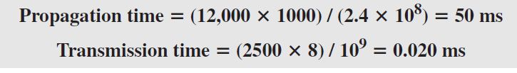
Example : What are the propagation time and the transmission time for a 2.5-KB (kilobyte) message if the bandwidth of the network is 1 Gbps? Assume that the distance between the sender and the receiver is 12,000 km and that light travels at 2.4 × 10⁸ m/s.
Solution :
The propagation and transmission time can be calculated as

Slide 17
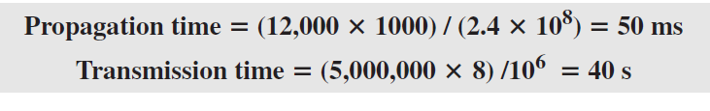
Example : What are the propagation time and the transmission time for a 5-MB (megabyte) message (an image) if the bandwidth of the network is 1 Mbps? Assume that the distance between the sender and the receiver is 12,000 km and that light travels at 2.4 × 10⁸ m/s.
Solution:
We can calculate the propagation and transmission times as

Slide 18
    Jitter
Another performance issue that is related to delay is jitter. We can roughly say that jitter is a problem if different packets of data encounter different delays and the application using the data at the receiver site is time-sensitive (audio and video data, for example). If the delay for the first packet is 20 ms, for the second is 45 ms, and for the third is 40 ms, then the real-time application that uses the packets endures jitter.

Slide 19
Summary of Discussion
In this session we have mainly discussed:
Transmission Impairments
Data Rate Limits
Performance

Slide 20


